Slide 1
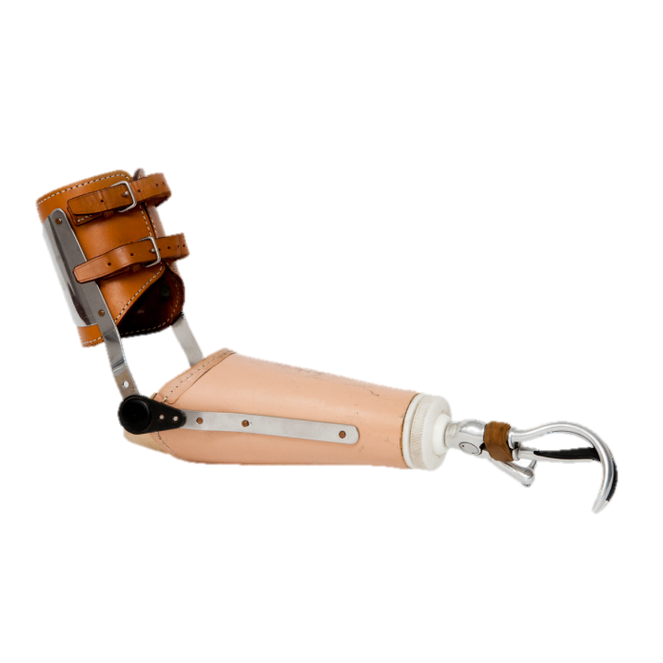
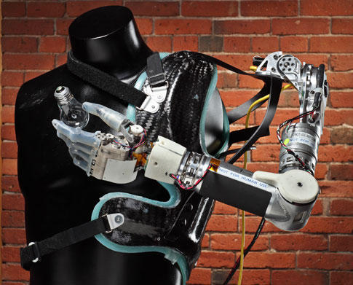
Prosthesis: Definition
An artificial device that replaces a missing body part
These devices work with muscle, skeleton, and (more recently) the nervous system to enhance motor control
Prosthetics can be used to replace a variety of body parts including but not limited to arms, legs, teeth, eyes, or heart valves

Slide 2
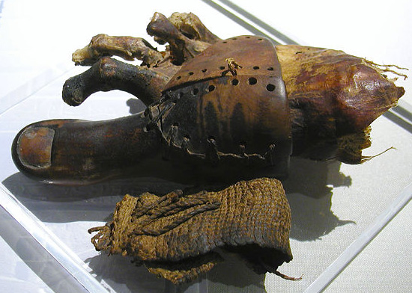

History
Prostheses date back to the ancient Egyptians and Greeks
Earliest mention of an artificial limb was around 500 B.C.
An artificial limb made of wood and copper dating back to 300 B.C. was found at Capri, Italy in 1858
During the Dark ages, debilitated knights would use prosthetics after losing limbs in battle.
Functional prosthetics began to become introduced more and more with new developments of Ambroise Paré in amputation surgery in the 1500s.
Ambroise Paré , a French Army barber/surgeon, is considered the father of modern amputation surgery and prosthetic design.

Slide 3
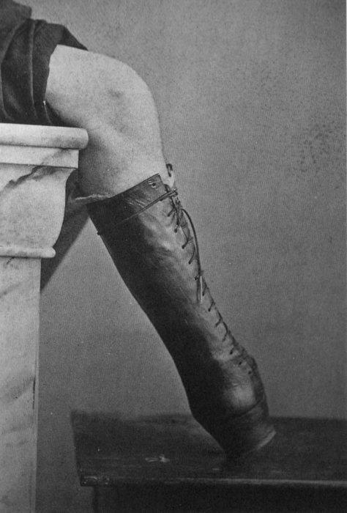
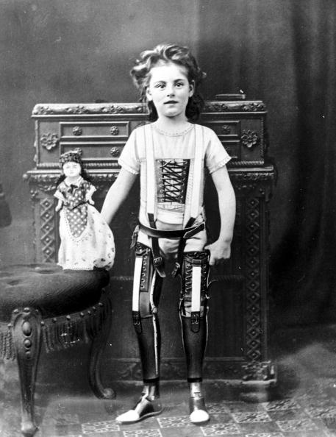
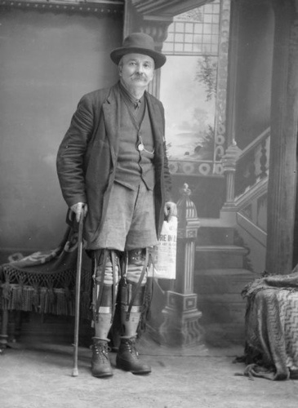
History
As time passed and technology became more advanced, prosthetics became more functional and intricate.

Slide 4
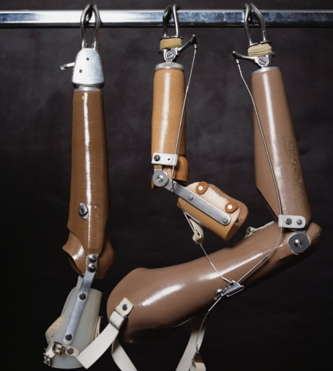
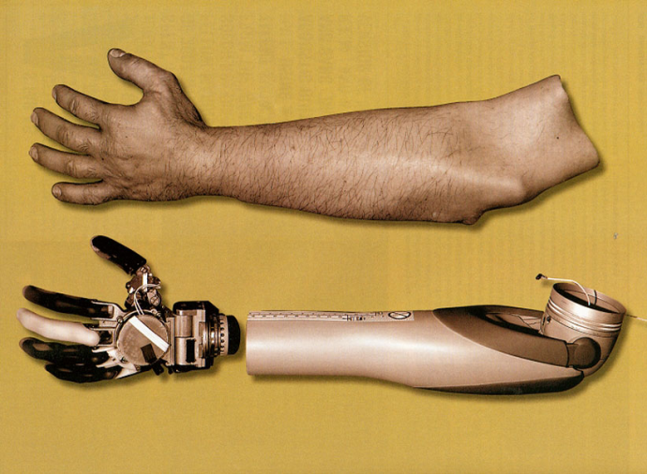
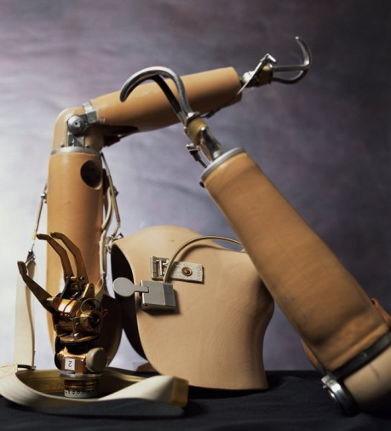
Traditional Prosthesis
Traditional prosthesis are not permanent
They are attached to the body using a number of methods, all of which allow for easy removal
The system of attachment is called the suspension system

Slide 5
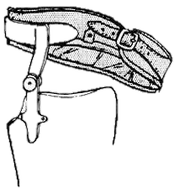
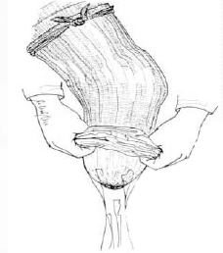
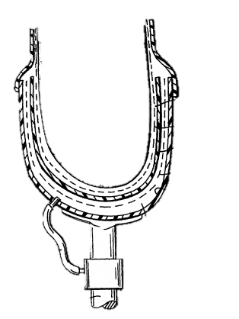
Existing Suspension Systems
Adjustable Sleeve
Achieves fit through a strap/buckle
Used in temporary situations, such as when the user’s body is adjusting to limb loss
Elastic Sleeve
Sleeve covers the patient’s stump
Uses friction/slight vacuum to keep limb in place
Utilizes Silicone gel for a more comfortable fit
Suction Socket
Creates vacuum between body and prosthesis
Artificial Limb can be taken on and off by opening a one-way valve
Better for blood flow

Slide 6
Downside & Limitations of Traditional Prosthesis
No direct connection to the body
There is no interface between human and limb
This means that complex control is impossible
Waste of energy
It takes about 80% more energy to walk with an above the knee prosthetic than it takes for an able-bodied person
This makes walking very tiring
Sweat causes irritation due to lack of airflow
This can cause skin rashes, blisters, and tissue breakdown
This irritation can also cause the stump to change size, changing fit
Temporary
Traditional prosthetics have a short lifespan, and need to be replaced every few years

